Slide 1
Malwina Tubielewicz-Michalczuk, PhD eng. architect Faculty of Civil Engineering Częstochowa University of Technology Department of Civil Engineering
"GREEN ROOFS" SURROUNDED BY DIVERSE KINDS OF URBAN LANDSCAPE

Slide 2
Introduction
Green roofs introduce a fragment of nature and at the same time reduce pollution and muffle noise; apart from the added aesthetic values, they improve the microclimate in urban agglomerations.
Properly designed, they have a recreational and regenerative function for the public. The modern, extensive parks can be regarded as a significant technical achievement.
In highly developed countries, such as Germany, Switzerland, Great Britain, the USA, Canada or Japan, green roofs are designed mainly to improve air quality, climatic conditions, and create places that enable the recreation of biological life; they are also an alternative to traditional rainwater storage.

Slide 3
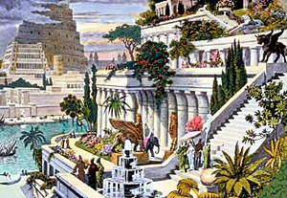
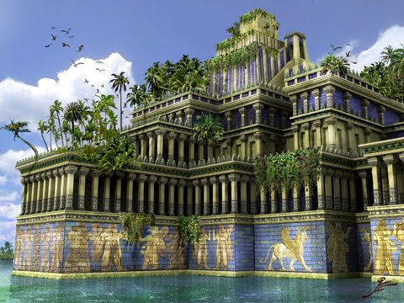
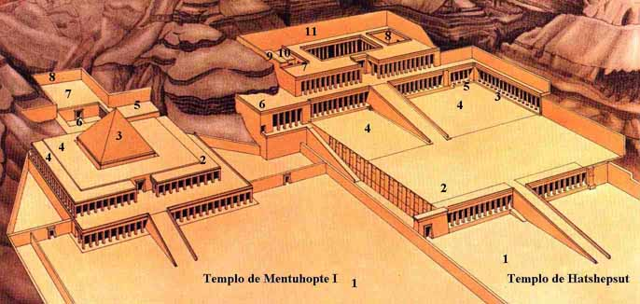
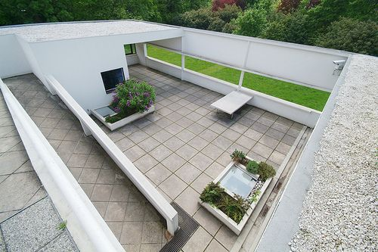
Roof gardens of different historical eras
The prototype of the green roofs was probably the hanging gardens of Babylon, which is now one of the seven wonders of the world. Roof gardens appeared in ancient Egypt. They decorated the mortuary temple for Hatshepsut (Deir el Bahari), which was carved in the rock. The vegetation was displayed on terraces on special ramps connected by fountains and pools.

Slide 4
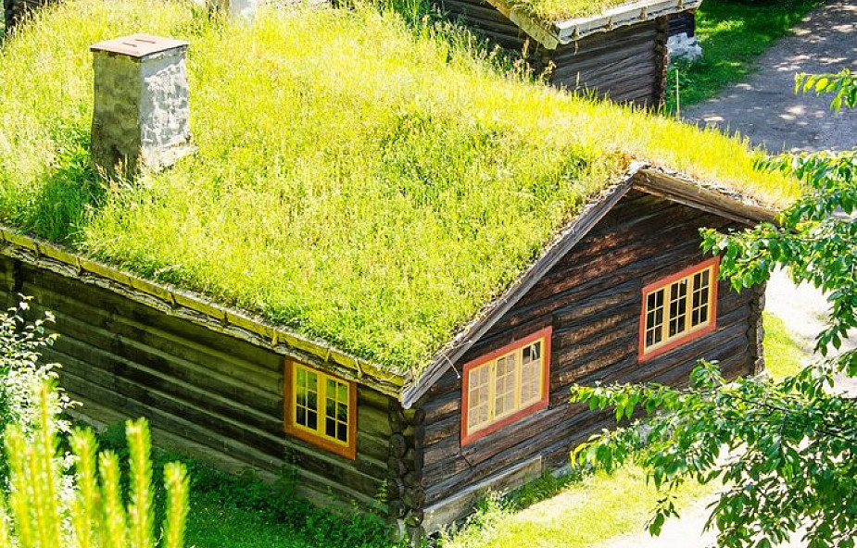
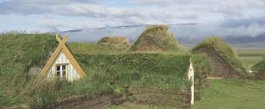
Roof gardens of different historical eras
In ancient times, green roofs were also popular in northern Europe. However, they were treated as good insulators against cold wind, snow and rain. They were made of turf, perennials and shrubs.

Slide 5
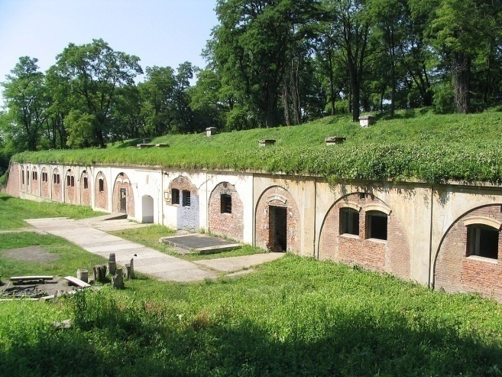
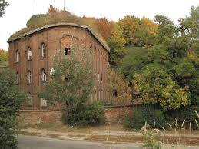
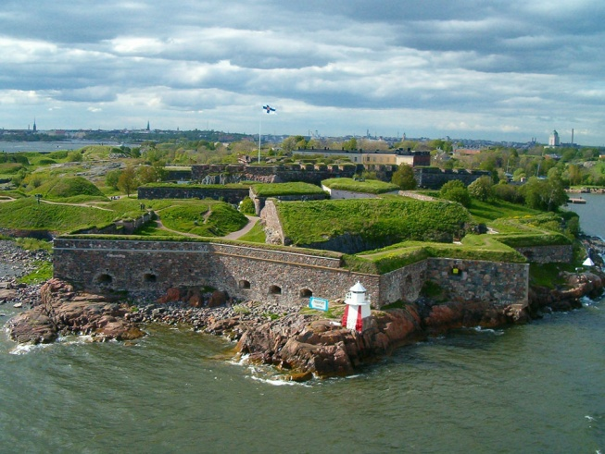
Roof gardens were more or less appreciated throughout the sixteenth and nineteenth centuries. Various compositions were created with the participation of fountains, sculptures and various plant species. During wars and battles, they masked fortifications, weapons and barracks.
Roof gardens of different historical eras

Slide 6
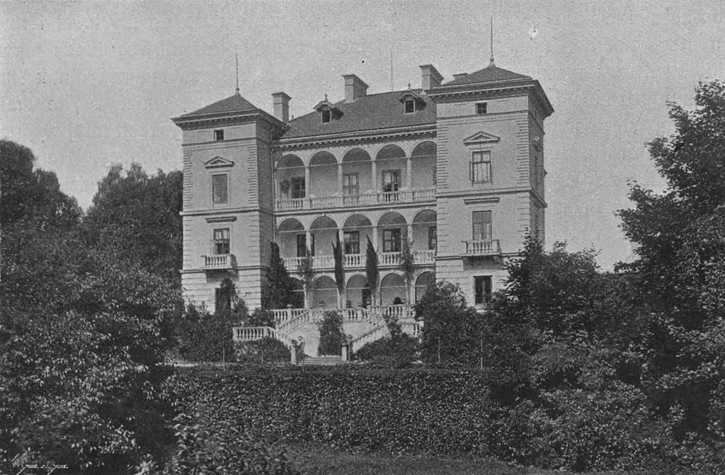
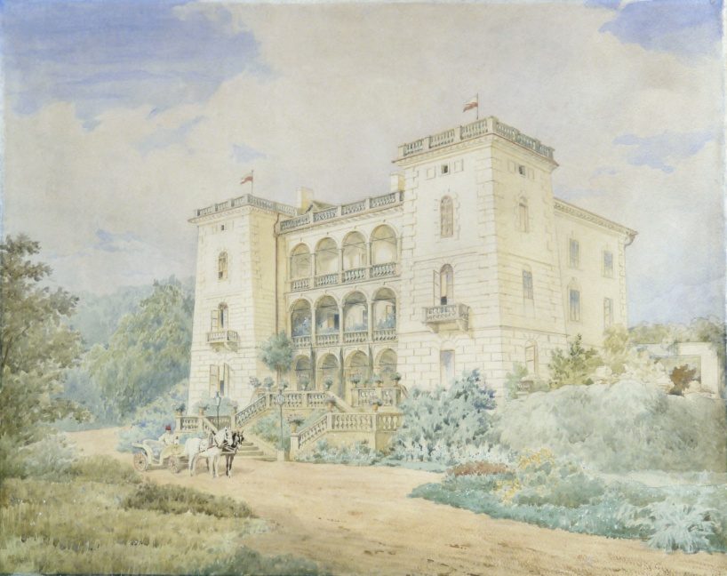
With the Renaissance, the roof gardens were restored, referring to antiquity, emphasizing the importance of vegetation, the splendor of colors, the richness of nature and symmetry. The southern ground floor of the garden is highlighted on the roof of the Orangery in Versailles, France. Plants adorned the reinforced terrace walls of the gardens at Villa d`Este in Italy, or at the Villa Decius in Wola Justowska in Crakow.
Roof gardens of different historical eras

Slide 7
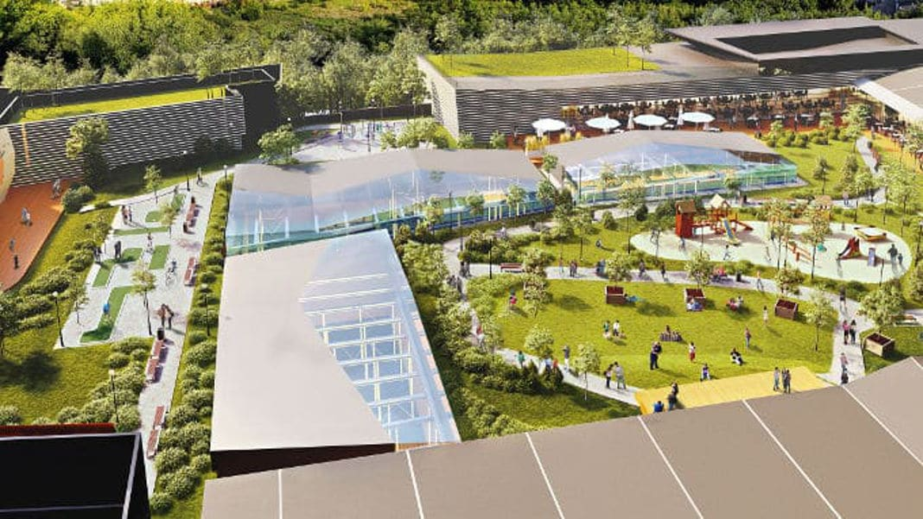
Types of green roofs
Intensive - is a usable roof, which is created due to the need to recreate a biologically active surface, usually on garage ceiling slabs or terraces.

Slide 8
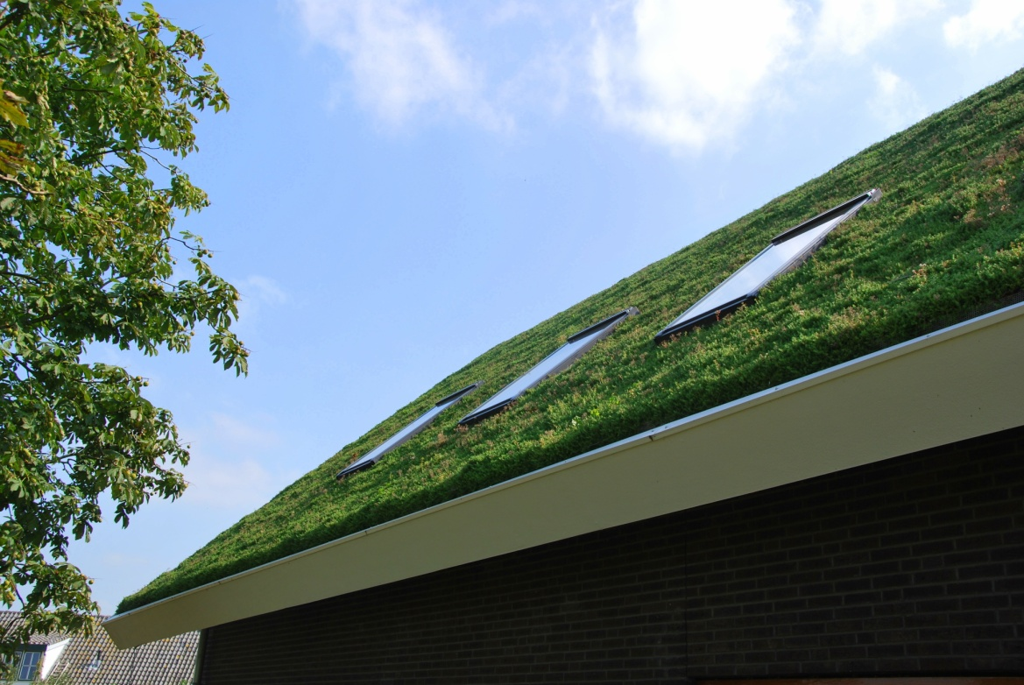
Types of green roofs
Extensive - this is a type of green roof, which is most often due to the smaller thickness of the structure and the load capacity. A green cover forms on its surface, which does not require increased care and which develops by itself.

Slide 9
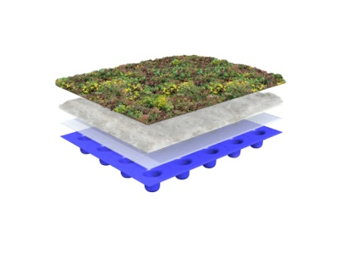
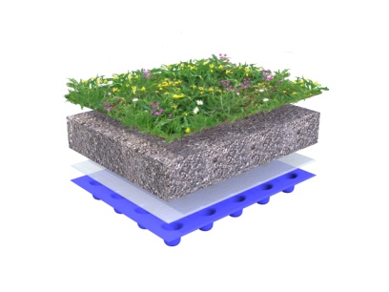
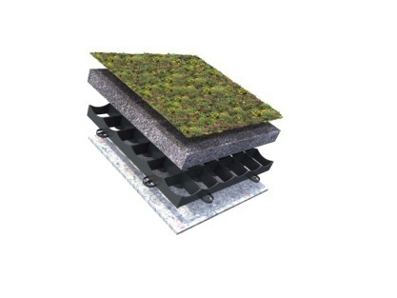
Green roof construction
The construction of a green roof depends on the specific conditions of a given roof. There are three basic ones:
Flat roof 0-5˚
Roof with a slight slope of 5-25˚
Steep sloping roof 25-45˚

Slide 10
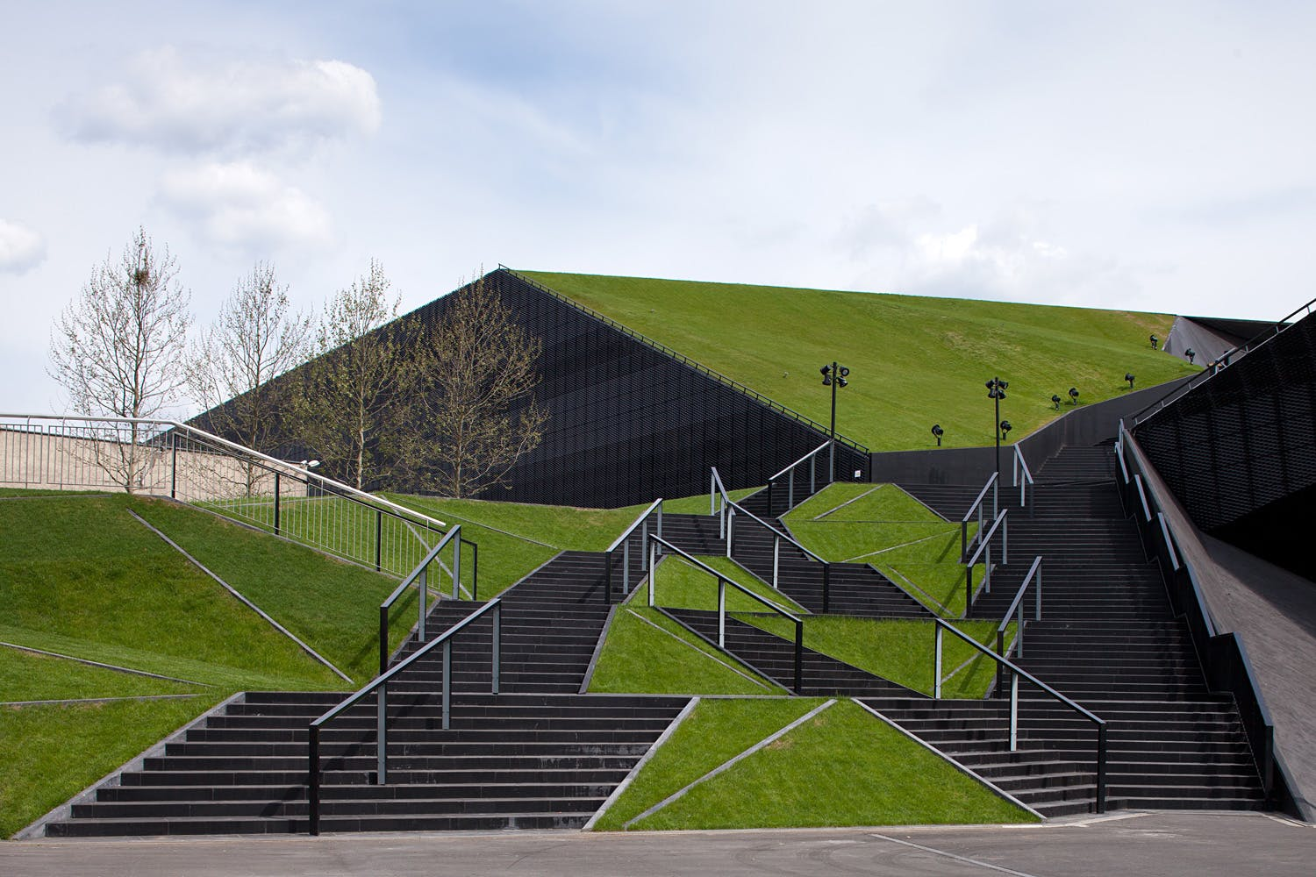
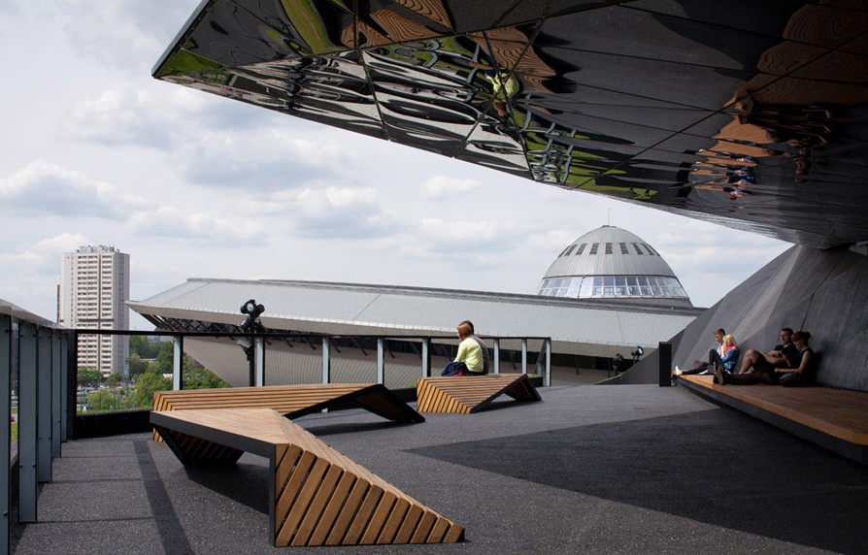
Green roofs in Poland – examples of projects
International Congress Centre, Katowice
The green roof of the International Congress Center in Katowice was built on the basis of a design by the leading Polish studio JEMS Architekci, selected in an international architectural competition concluded in October 2008.
The plastically formed green roof of the building together with the slope system perfectly harmonizes with the immediate surroundings, giving the building an individual character.

Slide 11
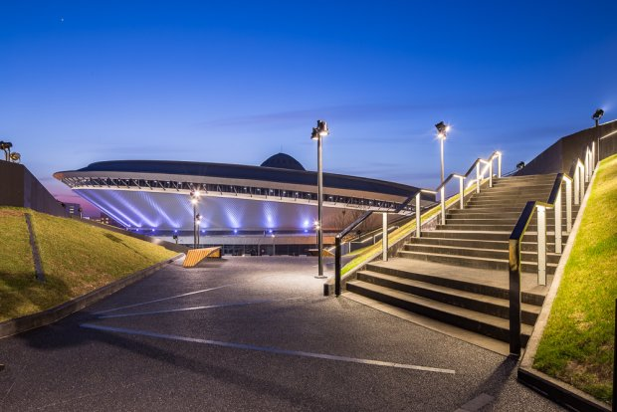
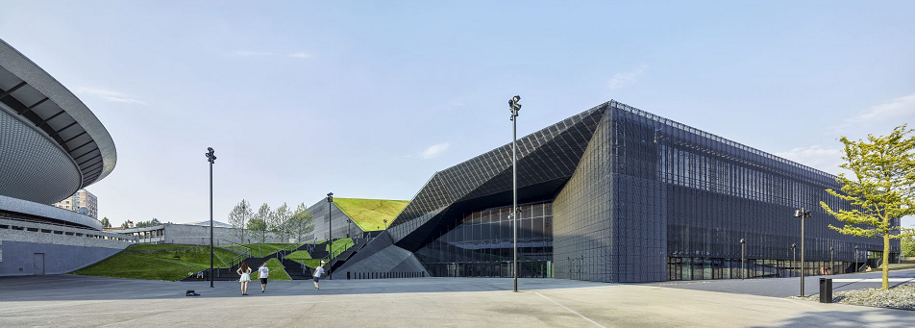
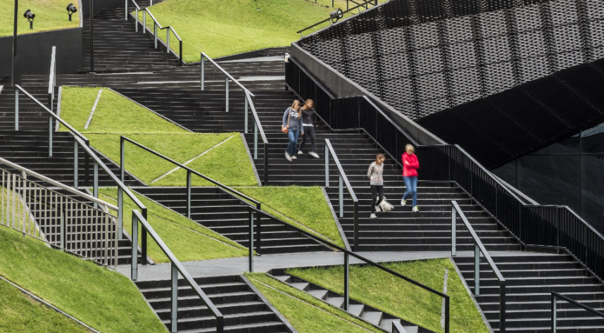
Green roofs in Poland – examples of projects
The view of the Spodek Arena and the International Congress Centre, Katowice
The carved roof descends stepwise to the alley running through the center of the building and ending with a panoramic opening to the adjacent Spodek.
The view of the stairs and green roof, Katowice

Slide 12
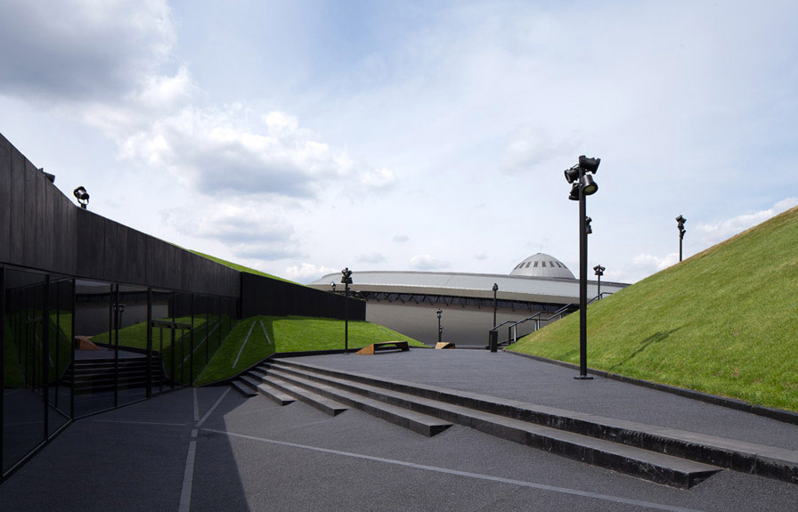
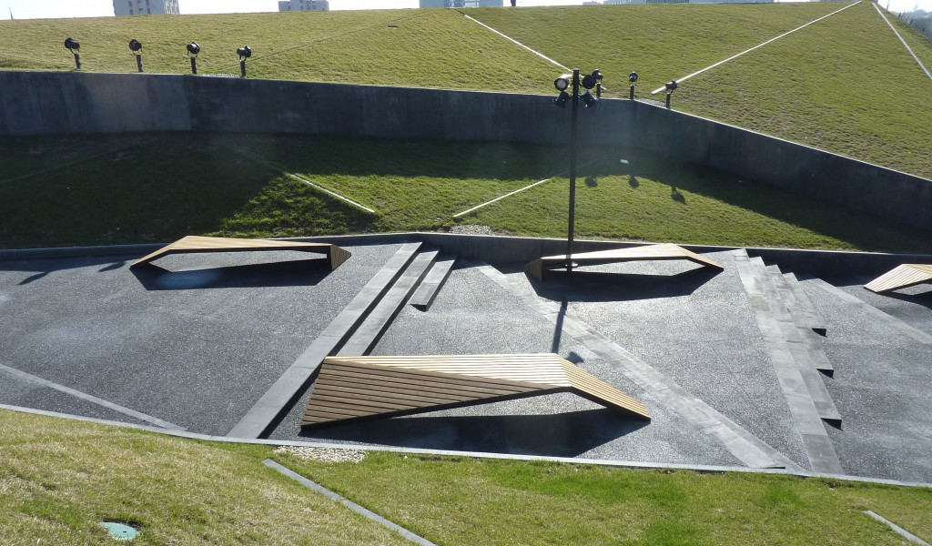
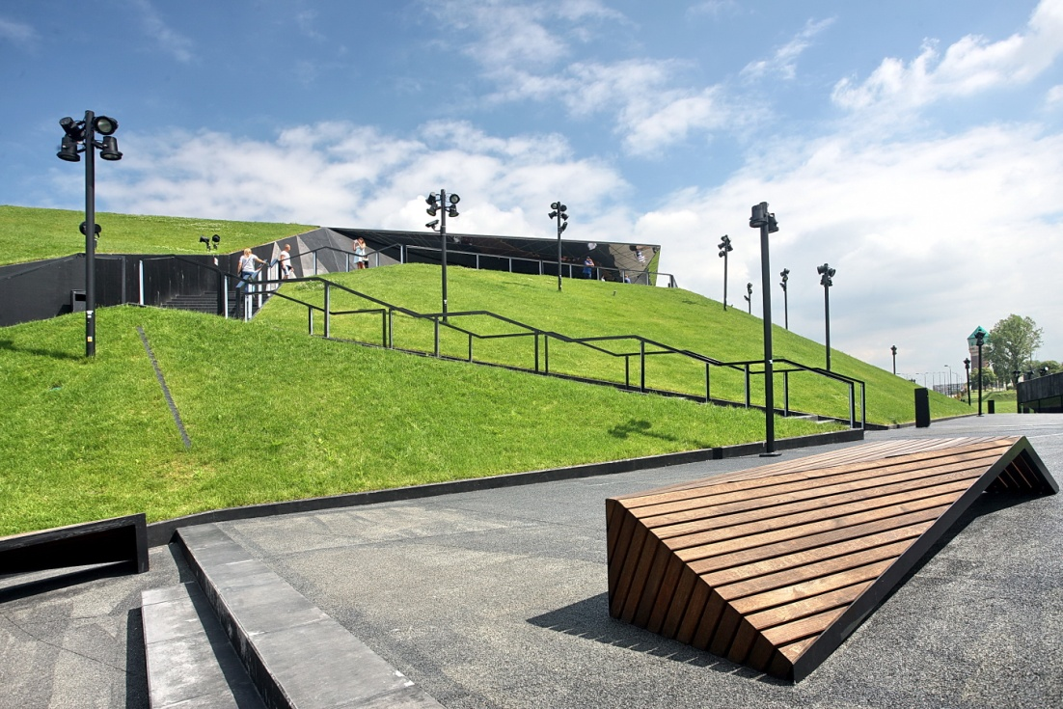
International Congress Centre, Katowice

Slide 13
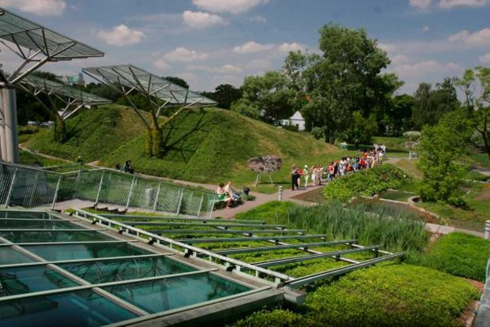
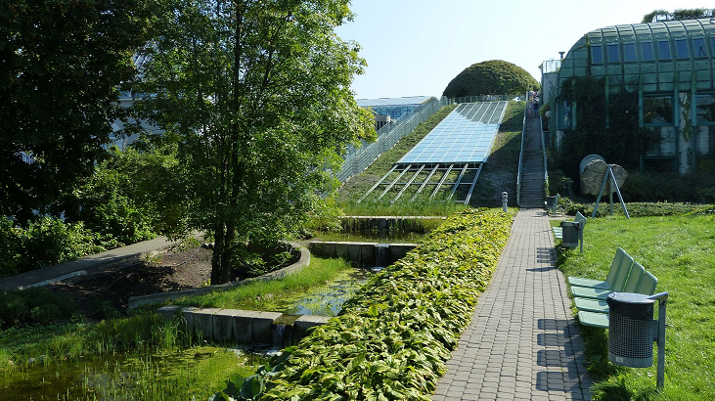
Green roofs in Poland – examples of projects
Library of the University of Warsaw
The garden consists of two parts: the upper (1.0 ha) and lower (1.5 ha), connected by a stream with cascading water. There you can admire a variety of plant species and varieties, planted in three differently composed parts. External entrances to the roof (ramp and elevator) make it easily accessible.
The roof garden of the University Library in Warsaw was opened on June 12, 2002. It is one of the largest roof gardens in Europe. It covers an area of over 1 ha. The vegetation covers 5111 m². Designed by landscape architect Irena Bajerska. As a university garden, i.e. generally accessible (although fenced and closed), it is a perfect place to relax not only for students and researchers, but also for Warsaw residents.

Slide 14
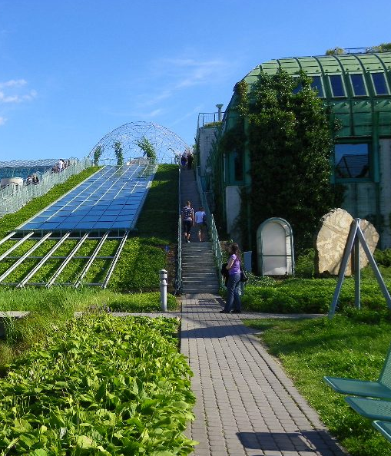
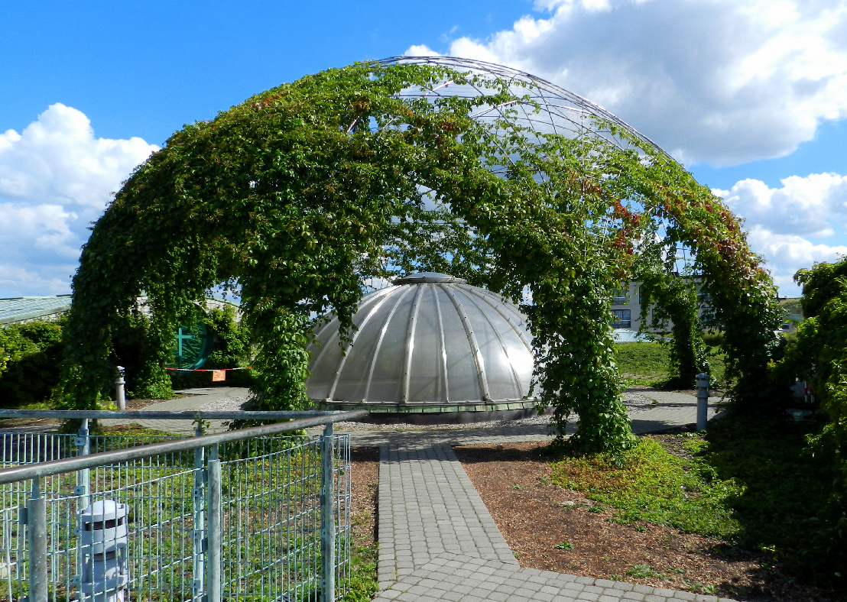
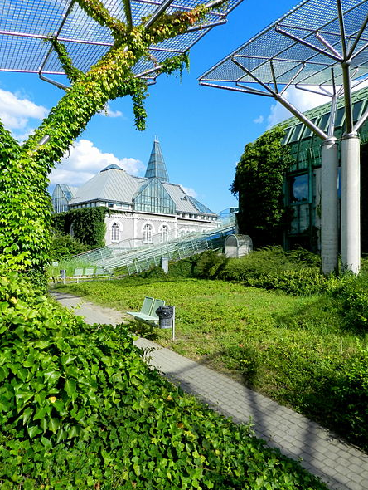
Library of the University of Warsaw
Visitors to the gardens can also look inside the Library from above through special windows or a glass roof. Entrance to the garden is free. All gardens are connected by footbridges, paths, bridges and pergolas on which vines grow.
The greatest decorations of the open space of the lower garden are, connected by a stream, an artificial stone with a cascade and a fish pond with ducks. Trees, shrubs and ornamental perennials were planted here in all seasons. The lower garden is also decorated with granite sculptures by Ryszard Stryjecki. It is divided into several parts that differ in form, color, smell and mood.

Slide 15
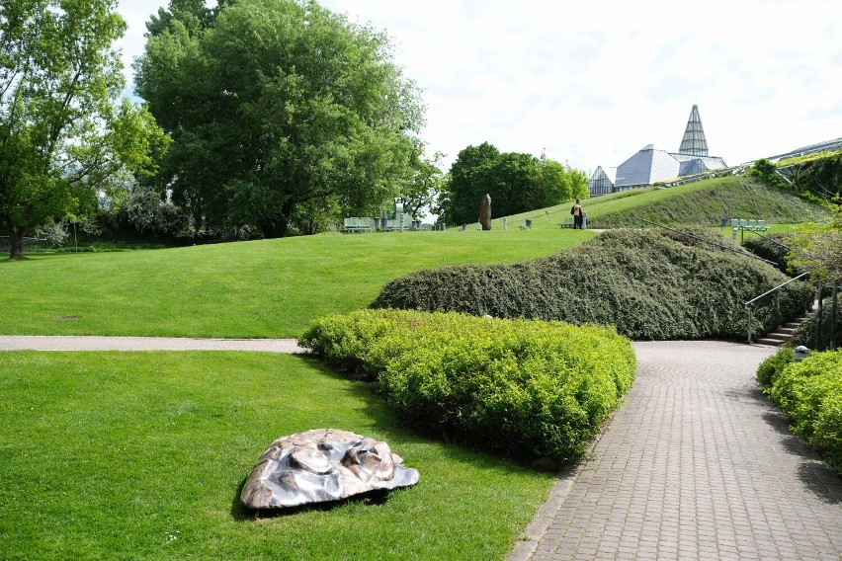
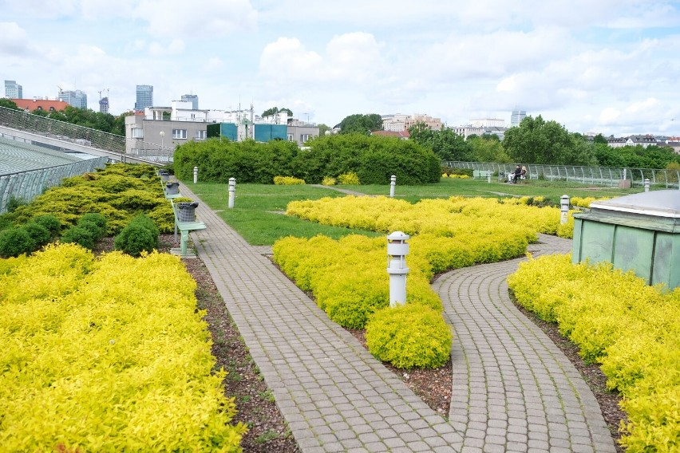
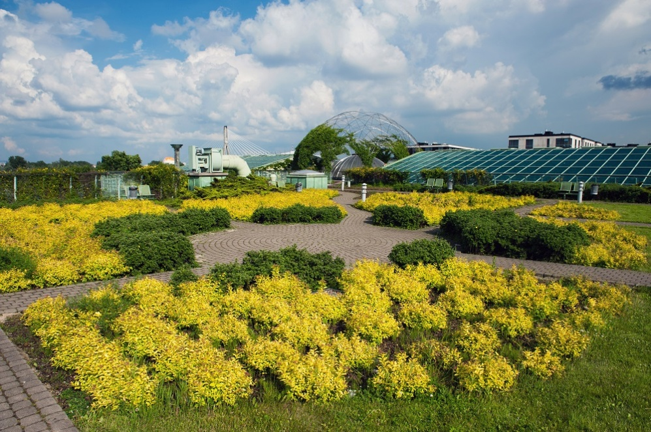
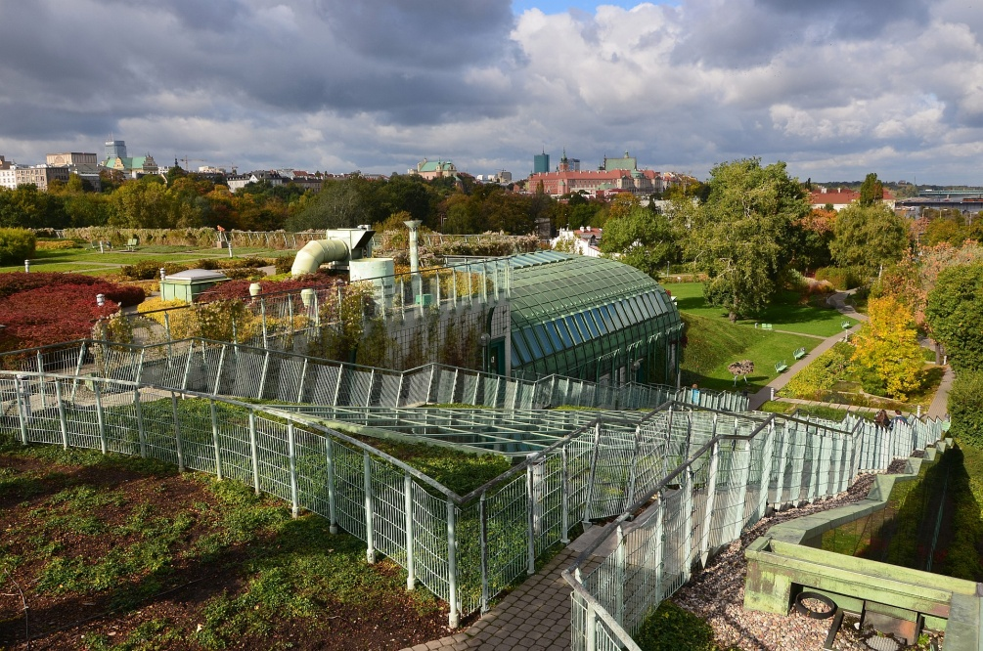
Green roofs in Poland – examples of projects
Library of the University of Warsaw

Slide 16
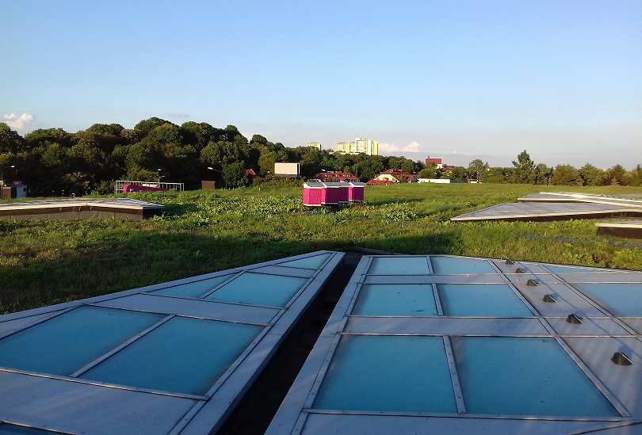
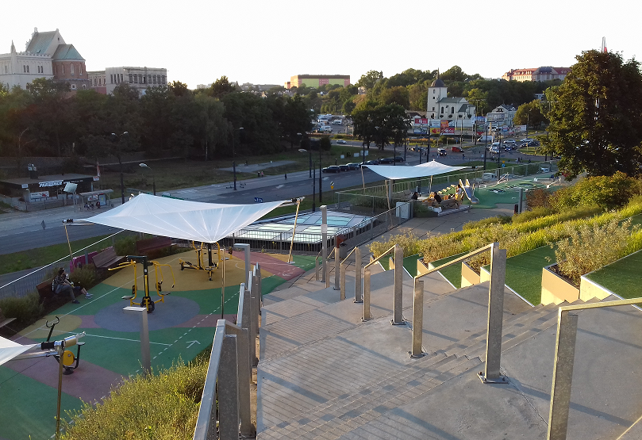
Green roofs in Poland – examples of projects
Tarasy Zamkowe, Lublin
Extensive roofs - technical space, Lublin
The roof intense – recreational space, the panorama of the city, Lublin

Slide 17
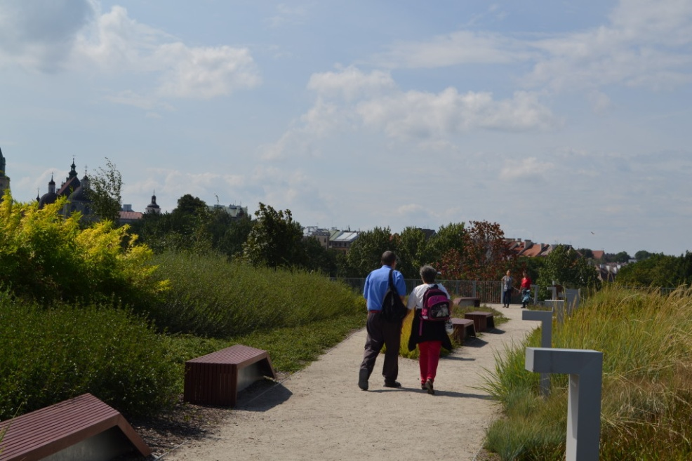
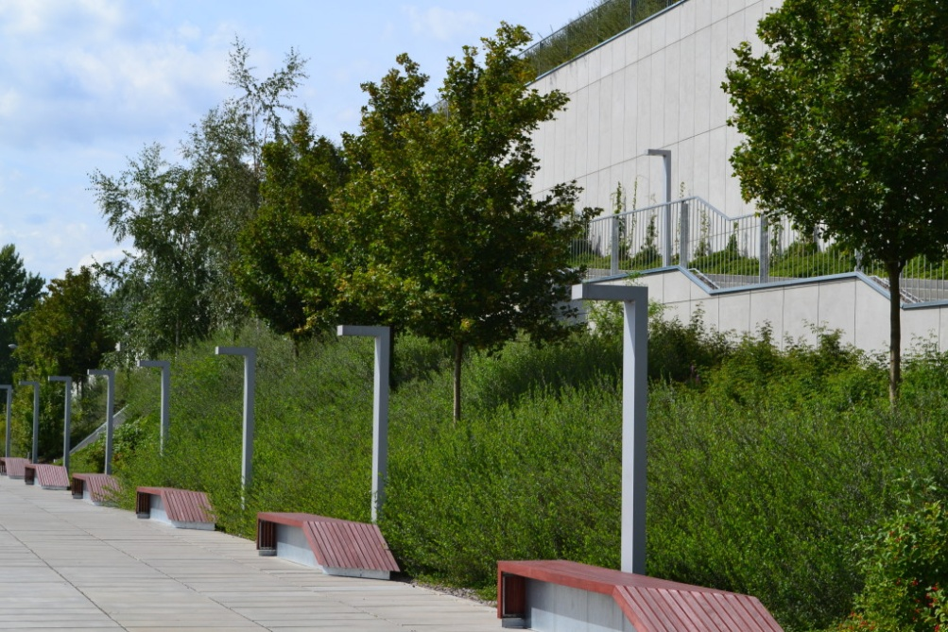
Green roofs in Poland – examples of projects
Tarasy Zamkowe, Lublin
The green roof on the "Tarasy Zamkowe" has become a meeting place - the possibility of walking on the green roof and admiring the panorama of Lublin's old town attracts visitors.

Slide 18
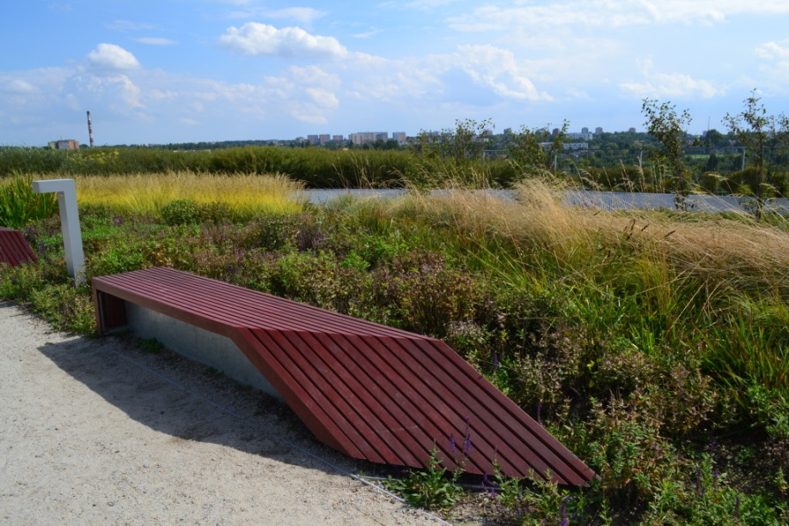
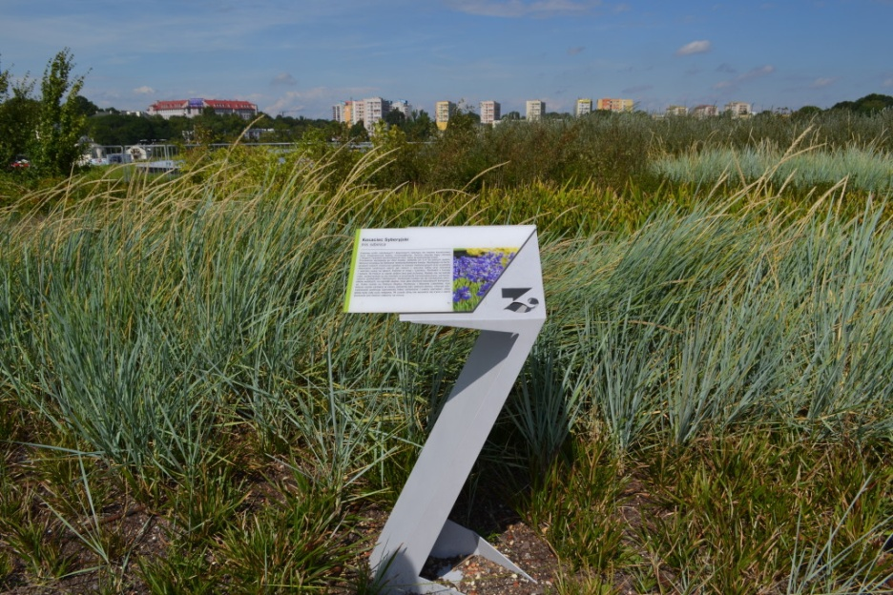
Green roofs in Poland – examples of projects
Tarasy Zamkowe, Lublin
The plants have been selected to create an endemic system with a regional character.

Slide 19
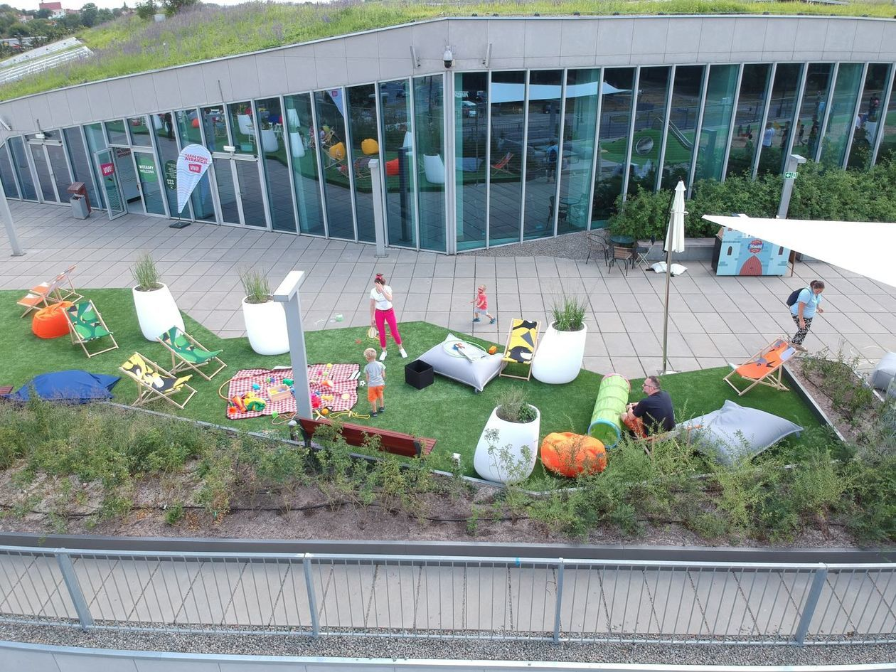
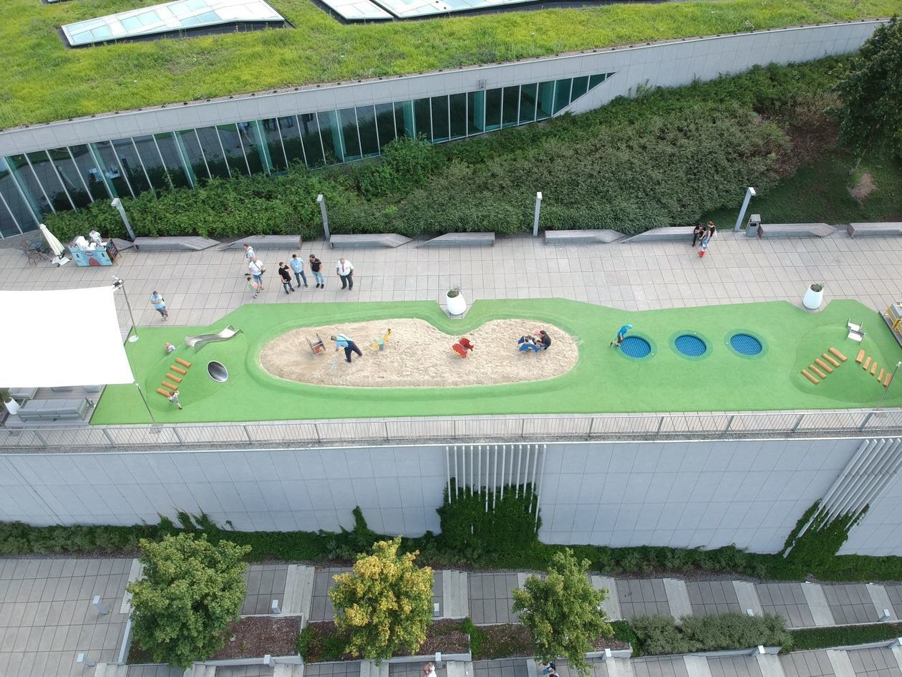
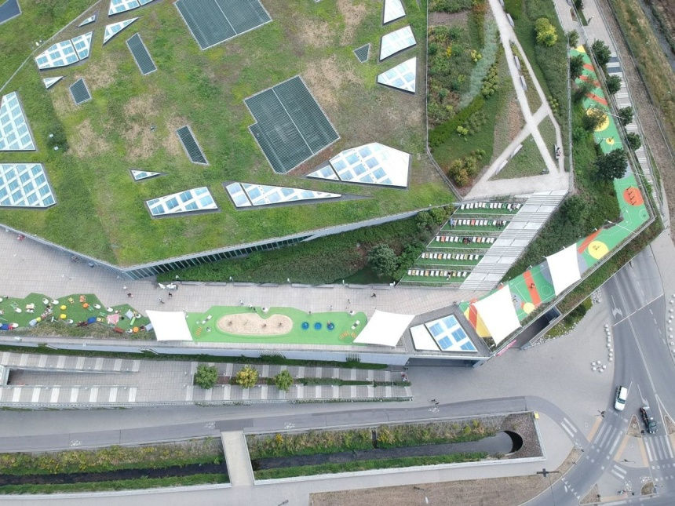
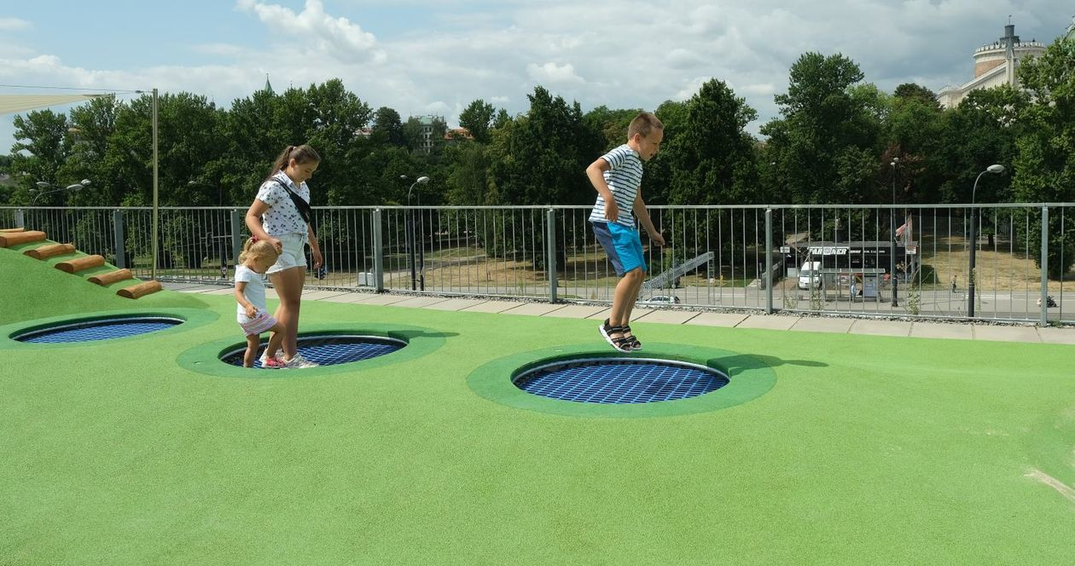
Green roofs in Poland – examples of projects
Tarasy Zamkowe, Lublin

Slide 20
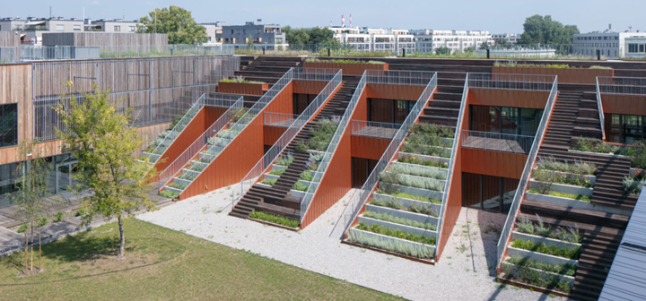
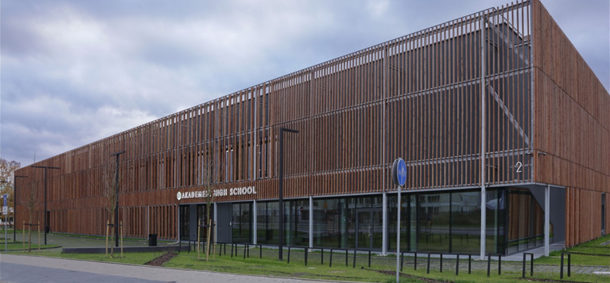
Green roofs in Poland – examples of projects
High School, Warsaw
Private high school. A model of the 21st century school by the Medusa Group design office.
Spaces for classes and creative work (hundred-meter art studio, music room, photo studio, comfortable sports space).
Eco – roof – ecological garden on the roof of the school.
The garden has been designed to maintain both aesthetic and practical needs. As part of the classes, students grow herbs, vegetables, fruits, flowers.
Nomination for the Mies van der Rohe Award 2019

Slide 21
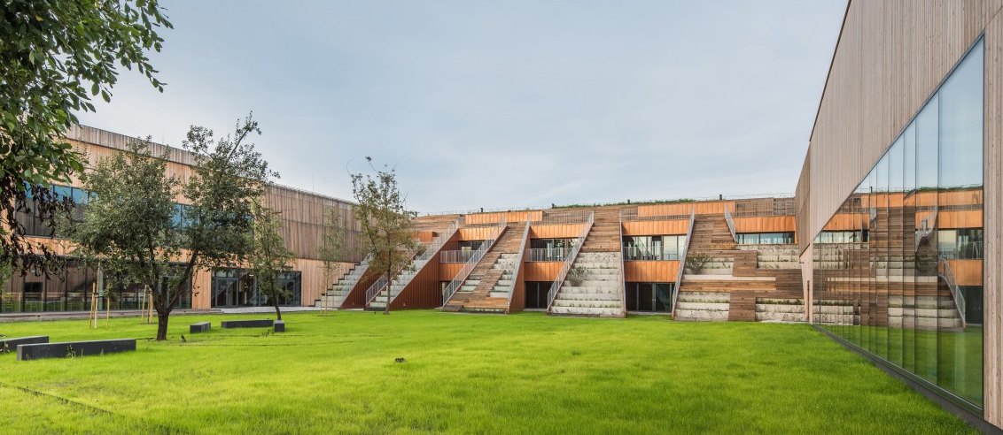
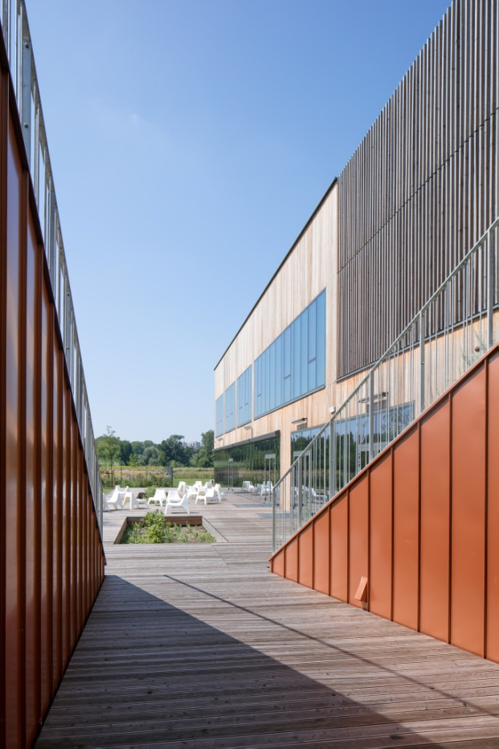
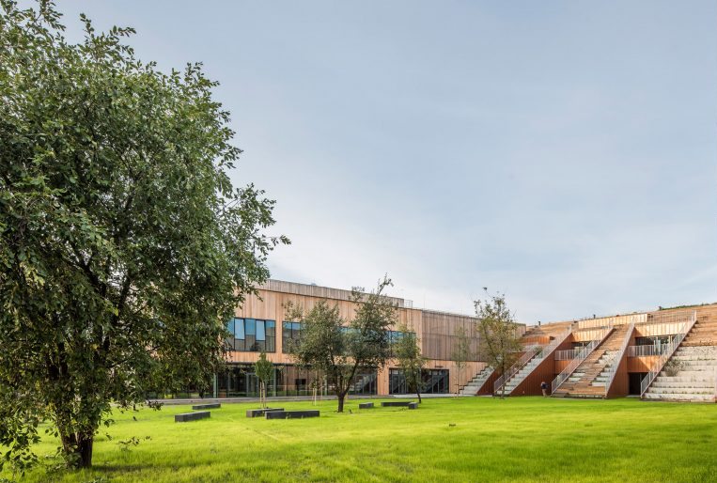
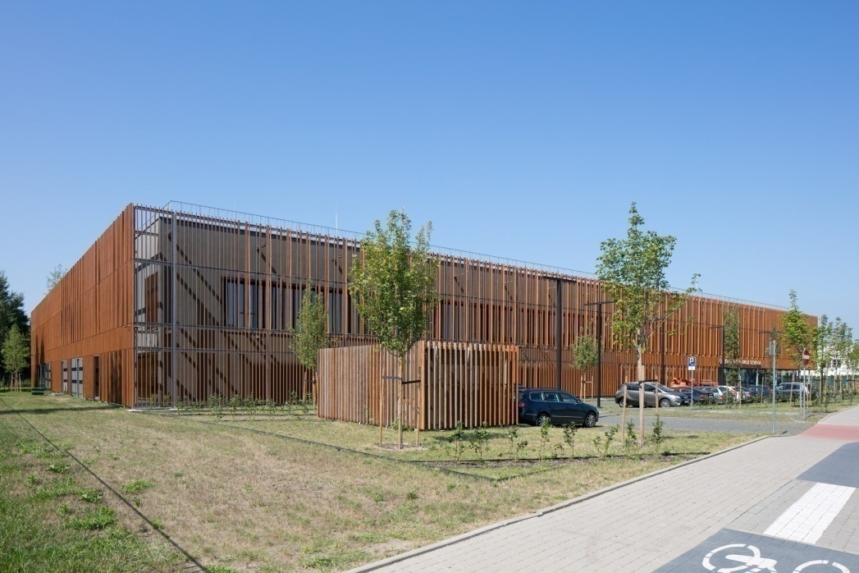
Green roofs in Poland – examples of projects
High School, Warsaw

Slide 22
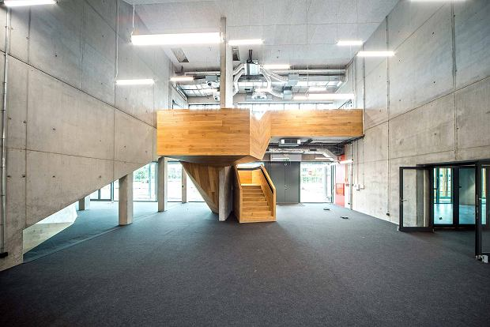
Green roofs in Poland – examples of projects
High School, Warsaw
Nomination for the Mies van der Rohe Award 2019

Slide 23
Applications
Green roofs primarily reduce the noise and hustle and bustle of the streets and are a great insulator on hot days. They retain rainwater, which allows for a greater moisture balance, and very importantly, green areas produce oxygen, purify the air, and contact with nature is calming. In the era of concrete urban structures and due to the limited possibilities of creating green areas on the ground, the roof is an ideal urban, but also ecological alternative.
Additionally, green areas blend in beautifully with the urban space.
1. Tubielewicz-Michalczuk M., Projektowanie i realizacja założeń architektonicznych w zrównoważonym kształtowaniu środowiska miejskiego, Wydawnictwo Politechniki Częstochowskiej, Częstochowa 2020, p.32.
2. Kożuchowski P., Piątek-Kożuchowska E., Dachy zielone w Polsce. Problemy zagospodarowania wód opadowych. Wydawnictwo Seidel-Przywecki. Wrocław 2008, p. 34.
3. Majdecki L., Historia ogrodów. Tom 1. Od starożytności po barok, Wydawnictwo Naukowe PWN, Warsaw 2010, p. 23.
4. Siewniak M., Mitkowska A., Tezaurus sztuki ogrodowej, Oficyna Wydawnicza Rytm, Warsaw 1998, p. 278.
5. Rooftop Garden, Hong Kong Architecture Science Press, Gingko Press, Berkeley 2013, p. 2.
6. Broniewski T., Historia architektury dla wszystkich, Wydawnictwo Ossolineum, Wrocław 1990, p.522
7. Szajda-Birnfeld E., Pływaczyk A., Skarżyński D., Zielone dachy: zrównoważona gospodarka wodna na terenach zurbanizowanych, Wydawnictwo Uniwersytetu Przyrodniczego, Wrocław 2012, p.45.
8. Kowalczyk A., Zielone dachy szansą na zrównoważony rozwój terenów zurbanizowanych, „Zrównoważony Rozwój – Zastosowania, nr 2, Wydawnictwo Fundacja Sendzimira, Cracow 2011, pp.66-81.
9. Zachariasz A., Ogród publiczny w centrum miasta – przemiany funkcji i formy, Czasopismo Techniczne – Architektura 2008 z.4-A, p. 299.
10. JEMS Architekci: https://jems.pl/ (accesed on 10 March 2023).
11. Bolesław Stelmach – the winner of the honorary award of the Association of Polish Architects, author of the Chopin Centre in
Warsaw (2009) and the Centre for the Meeting of Cultures in Lublin (2015).
12. SARP – Association of Polish Architects.
13. Medusa Group: https://www.medusagroup.pl (accesed on 20 March 2023).
LITERATURE

